Slide 1
CSE 3105 Software Engineering
Chapter 2: Process Models

Slide 2
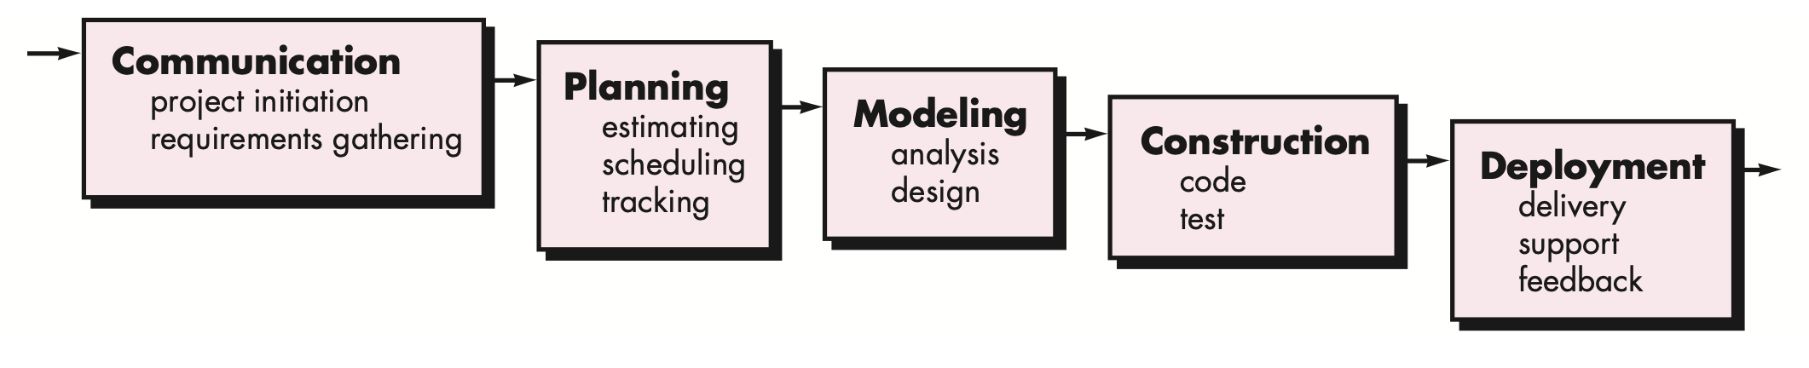
Waterfall Process Model

Slide 3
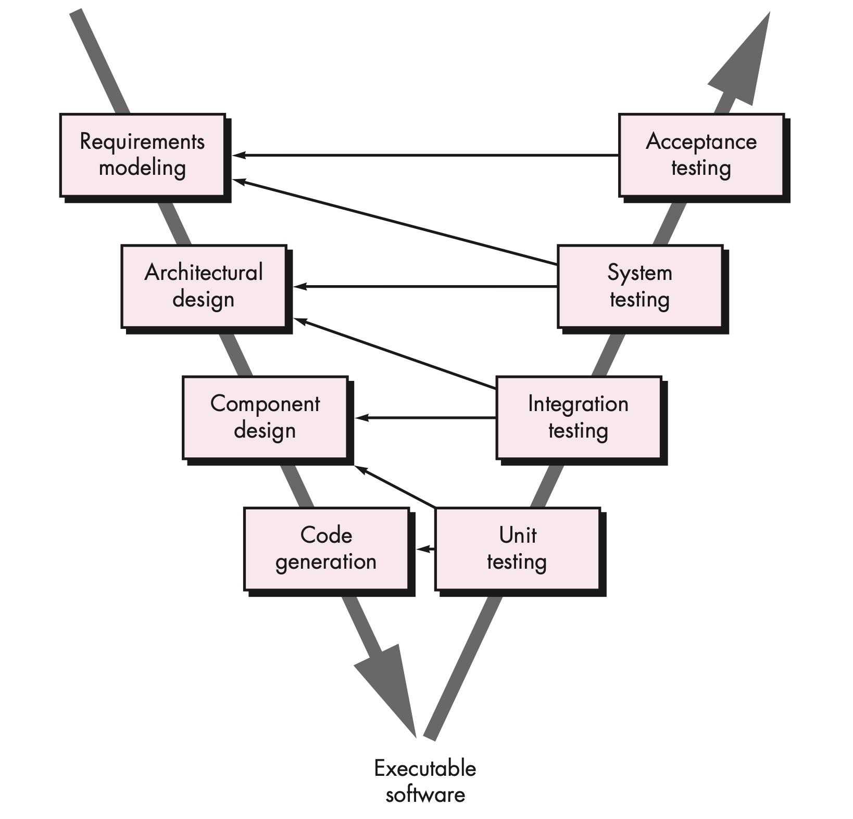
The V-Model

Slide 4
Problems with Waterfall model
Real projects rarely follow the sequential flow that the model proposes. Although the linear model can accommodate iteration, it does so indirectly. As a result, changes can cause confusion as the project team proceeds.
It is often difficult for the customer to state all requirements explicitly. The waterfall model requires this and has difficulty accommodating the natural uncertainty that exists at the beginning of many projects.
The customer must have patience. A working version of the program(s) will not be available until late in the project time span. A major blunder, if undetected until the working program is reviewed, can be disastrous.

Slide 5
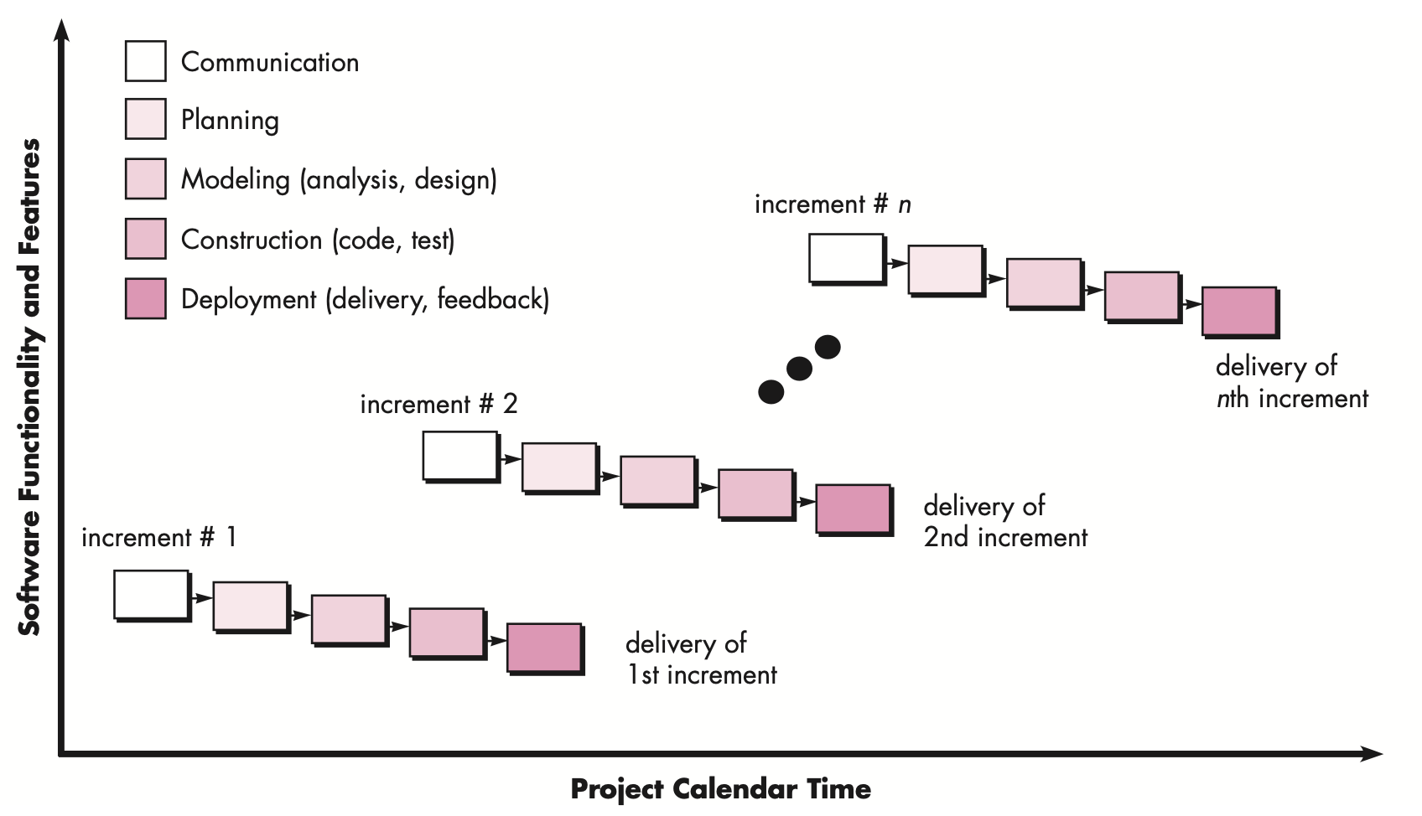
The Incremental Process Model

Slide 6
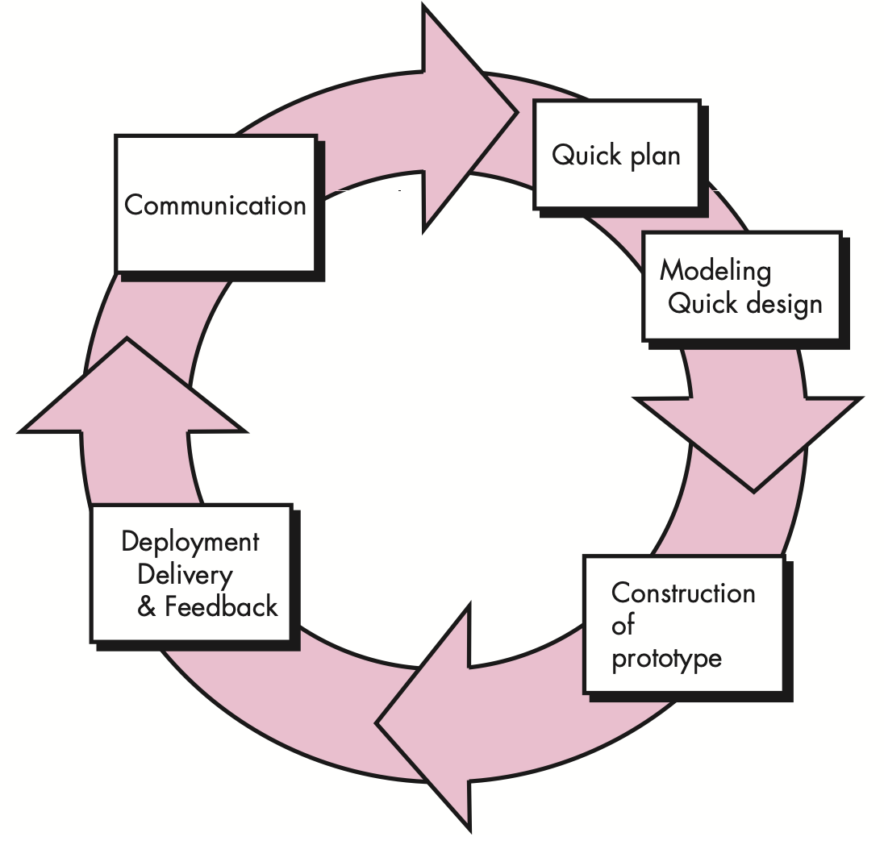
Evolutionary Process Models: The Prototyping paradigm

Slide 7
Problems with prototyping
Stakeholders see what appears to be a working version of the software, unaware that the prototype is held together haphazardly, unaware that in the rush to get it working you haven’t considered overall software quality or long-term maintainability.
As a software engineer, you often make implementation compromises in order to get a prototype working quickly. An inappropriate operating system or programming language may be used simply because it is available and known; an inefficient algorithm may be implemented simply to demonstrate capability. After a time, you may become comfortable with these choices and forget all the reasons why they were inappropriate. The less-than-ideal choice has now become an integral part of the system.

Slide 8
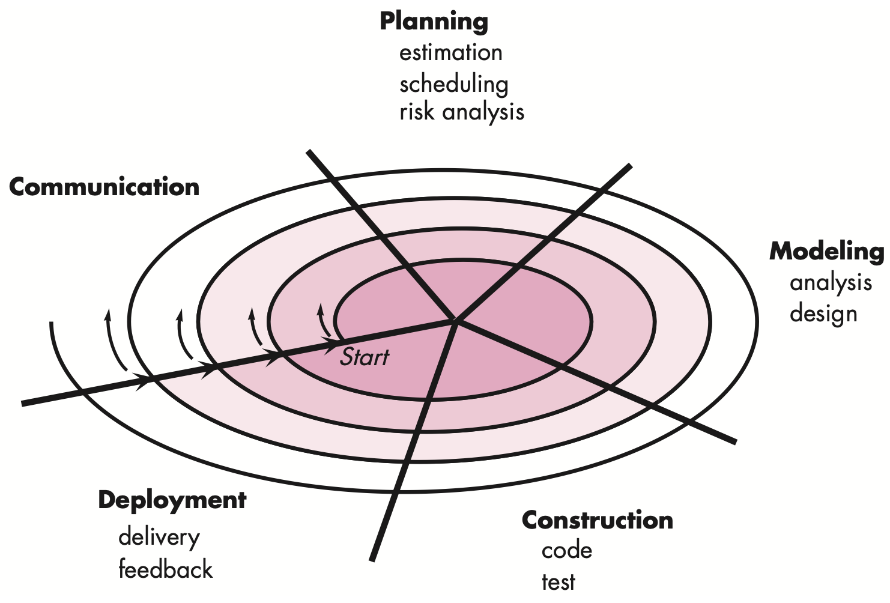
Evolutionary Process Models: The Spiral Model

Slide 9
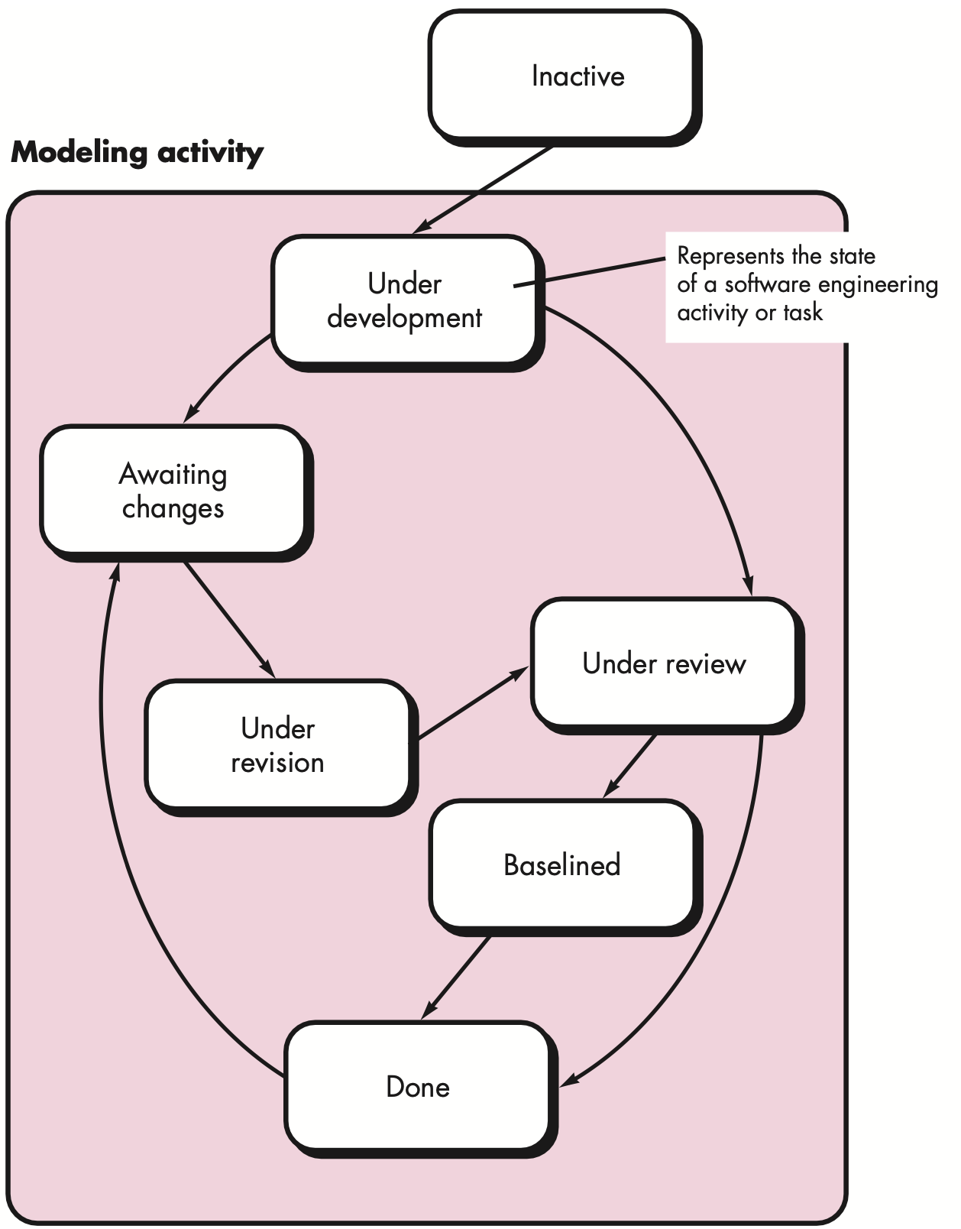
Concurrent Model

Slide 10
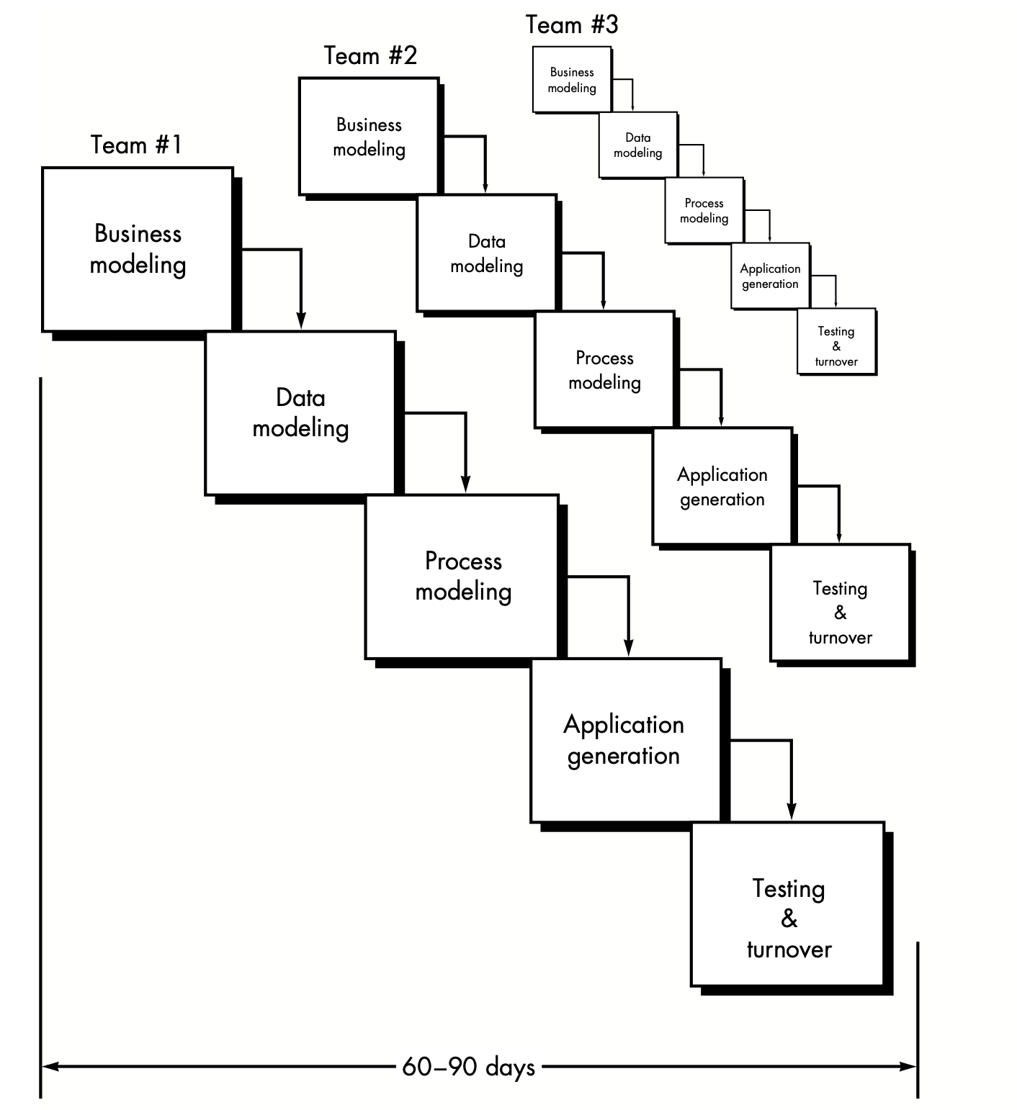
The RAD Model

Slide 11
The RAD Model
Business Modeling: What information drives the business process? What information is generated? Who generates it? Where does the infor- mation go? Who processes it?
Data modelling: The information flow defined as part of the business modeling phase is refined into a set of data objects that are needed to support the business
Process modelling: The data objects defined in the data modeling phase are trans- formed to achieve the information flow necessary to implement a business function. Processing descriptions are created for adding, modifying, deleting, or retrieving a data object.
Application generation
Testing and turnover: Since the RAD process emphasizes reuse, many of the pro- gram components have already been tested. This reduces overall testing time. How- ever, new components must be tested and all interfaces must be fully exercised.

Slide 12
Drawbacks of RAD model
For large but scalable projects, RAD requires sufficient human resources to create the right number of RAD teams.
RAD requires developers and customers who are committed to the rapid-fire activities necessary to get a system complete in a much abbreviated time frame. If commitment is lacking from either constituency, RAD projects will fail.
Not all types of applications are appropriate for RAD. If a system cannot be properly modularized, building the components necessary for RAD will be problematic. If high performance is an issue and performance is to be achieved through tuning the interfaces to system components, the RAD approach may not work.
RAD is not appropriate when technical risks are high. This occurs when a new application makes heavy use of new technology or when the new software requires a high degree of interoperability with existing computer programs.

Slide 13
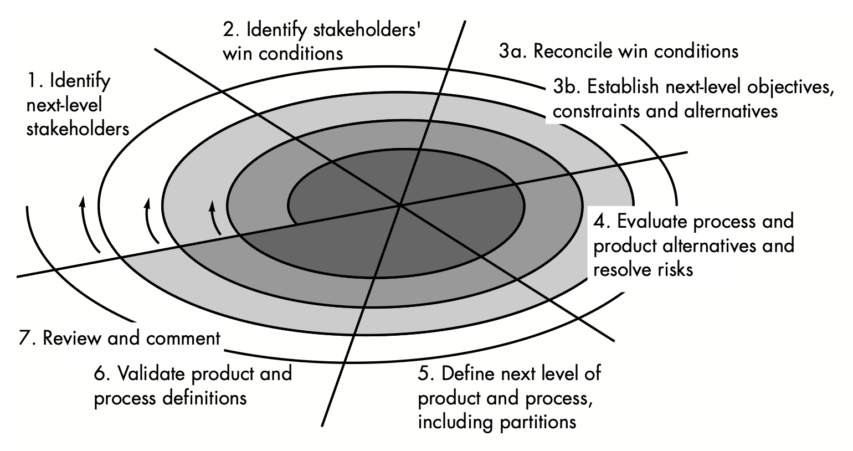
WINWIN Spiral Model

Slide 14
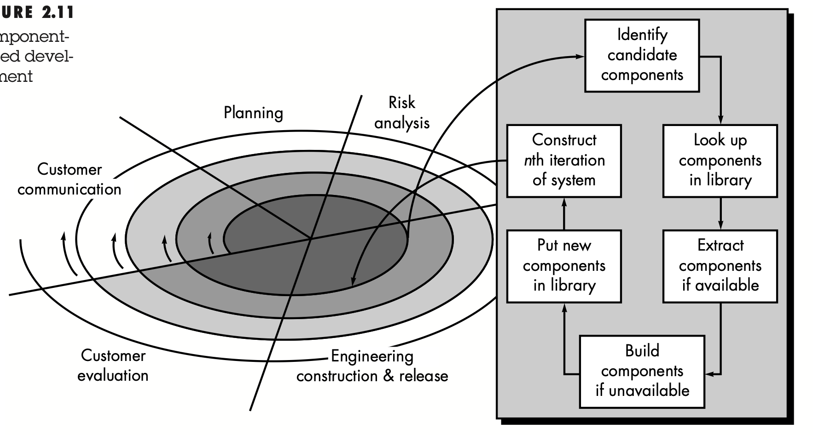


Component Based Development

